Slide 1

Spotify data for songs 1950-2020
Team 21

Slide 2
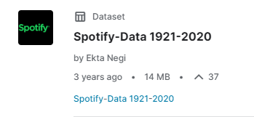
The Dataset
Why did we choose the dataset we did (Spotify Song Data 1920 - 2020)?
How we fixed representation of Cyrillic characters?
How did we optimise the dataset?
What fields are within the data set?

Slide 3
What are these fields
The fields themselves represent data that the Spotify API uses to assign a value to each songs features.
Some of these fields are fairly simple such as:
Artist
Album
Song Title
Release Year
BPM
Some of the other fields require some explanation

Slide 4
Spotify API Attributes http://sortyourmusic.playlistmachinery.com/#:~:text=Tap%20into%20the%20power%20of%20Spotify%27s%20song%20attributes&text=Energy%20-%20The%20energy%20of%20a,value%2C%20the%20louder%20the%20song.
Energy - The energy of a song - the higher the value, the more energetic song (e.g. Get Out My Head by Redlight)
Danceability - The higher the value, the easier it is to dance to this song. (e.g. It’s Tricky by Run DMC)
Loudness - The higher the value, the louder the song. (e.g. Any song by Slipknot)
Valence - The higher the value, the more positive mood for the song. (e.g. Happy by Pharrell Williams)
Length - The duration of the song. (e.g. Master of Puppets by Metallica)
Acoustic - The higher the value the more acoustic the song is. (Most Classical Music)
Popularity - The higher the value the more popular the song is. (At the time this database was recorded, the most popular song was Blinding Lights by The WEEKND)

Slide 5
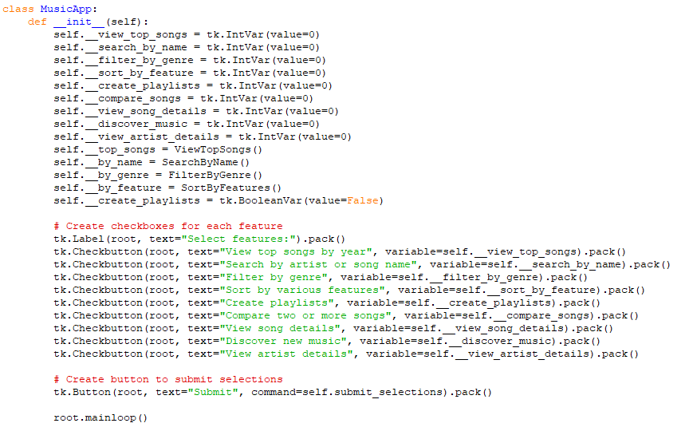
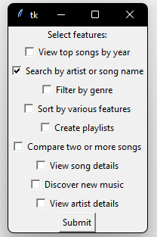
GUI

Slide 6
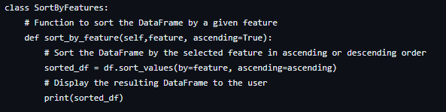
Code Segment 1 - Sorting by Features

Slide 7
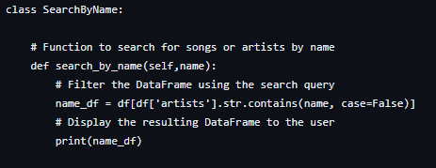
Code Segment 2 - Searching by Name (Artist or Song Title)

Slide 8
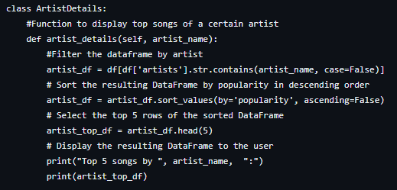
Code Segment 3 - Shows Artists Top Songs

Slide 9
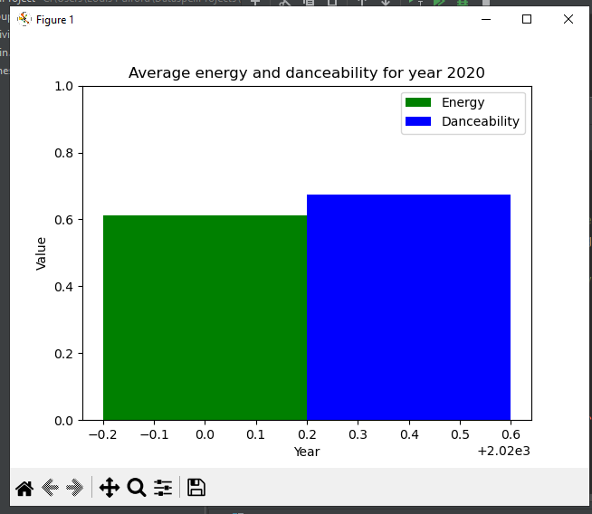
Dylan -Average Danceability and Energy for songs released during COVID-19

Slide 10
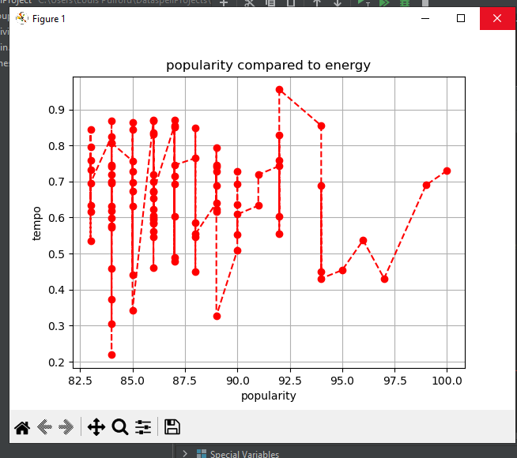
Louis – How this compares to the most popular music

Slide 11
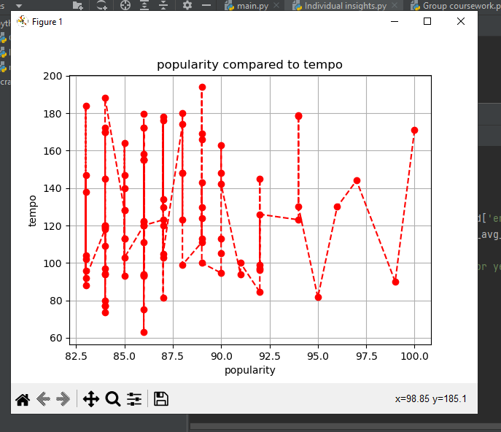
Paddy - Data Representation of the effect of tempo on popularity

Slide 12
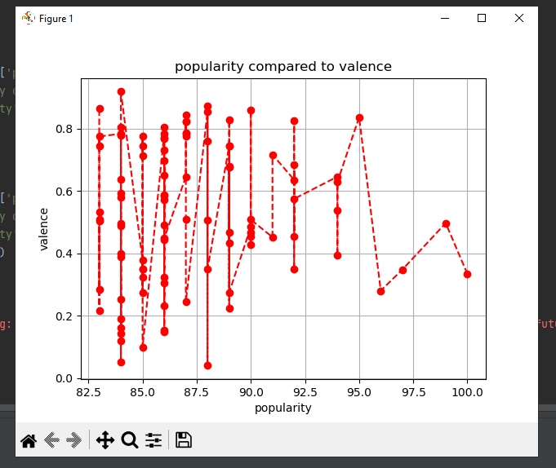
Ed - Popularity compared to Valence

Slide 13
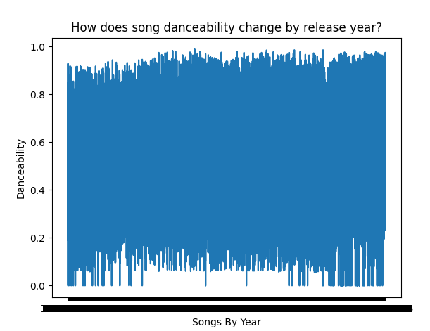
Charlie - How does song danceability change by release year

Slide 14
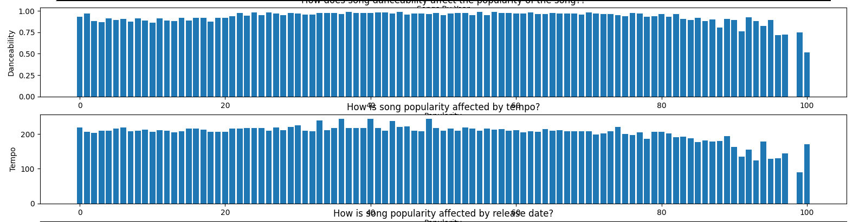

Slide 15
